Slide 1
EBN 111/122 ELECTRICITY AND ELECTRONICS
Chapter 9
Sinusoidal Steady-State Analysis

Slide 2
Sinusoids and Phasor Chapter 9
9.1 Motivation
9.2 Sinusoids’ features
9.3 Phasors
9.4 Phasor relationships for circuit elements
9.5 Impedance and admittance
9.6 Kirchhoff’s laws in the frequency domain
9.7 Impedance combinations

Slide 3
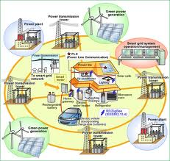
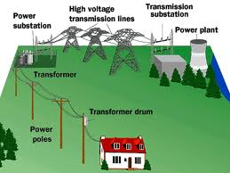
9.1 Motivation
AC = Alternating Current (Alternates between +and – )
Vast majority of Power Networks are AC networks because:
AC allows for easy stepping up and down of voltages which allows for efficient transfer of energy over long distances.

Slide 4
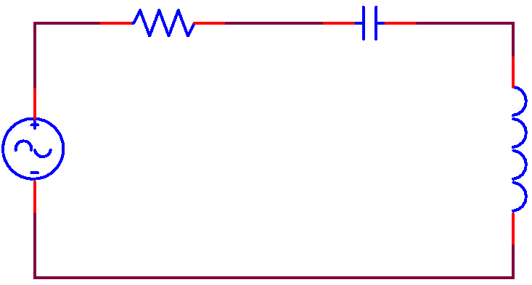


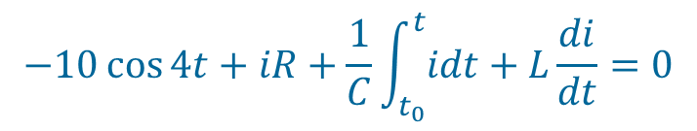
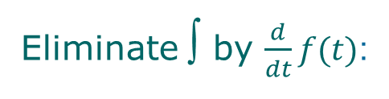


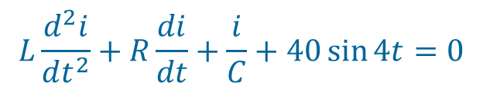

9.1 Motivation
How does one analyse an AC circuit?
R
C
Method #1:
Time domain
i
V_{s}
= 10cos4t
L
KVL:
$$−V_{s}+v_{R}+v_{c}+v_{L}=0$$
$$−10\cos{4t}+iR+\frac{1}{C}\int_{t_{0}}^{t}{idt}+L\frac{di}{dt}=0$$
Eliminate ∫ by $\frac{d}{dt}f(t)$:
$$L\frac{d^{2}i}{dt^{2}}+R\frac{di}{dt}+\frac{i}{C}+40\sin{4t}=0$$
2nd order differential equation with solutions:
$$i\left(t\right)=A_{i}\cos\left(4t+φ_{i}\right)$$
$$V_{C}\left(t\right)=A_{C}\cos\left(4t+φ_{C}\right)$$
$$V_{R}\left(t\right)=A_{R}\cos\left(4t+φ_{R}\right)$$
$$V_{L}\left(t\right)=A_{L}\cos\left(4t+φ_{L}\right)$$

Slide 5
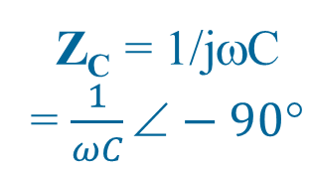
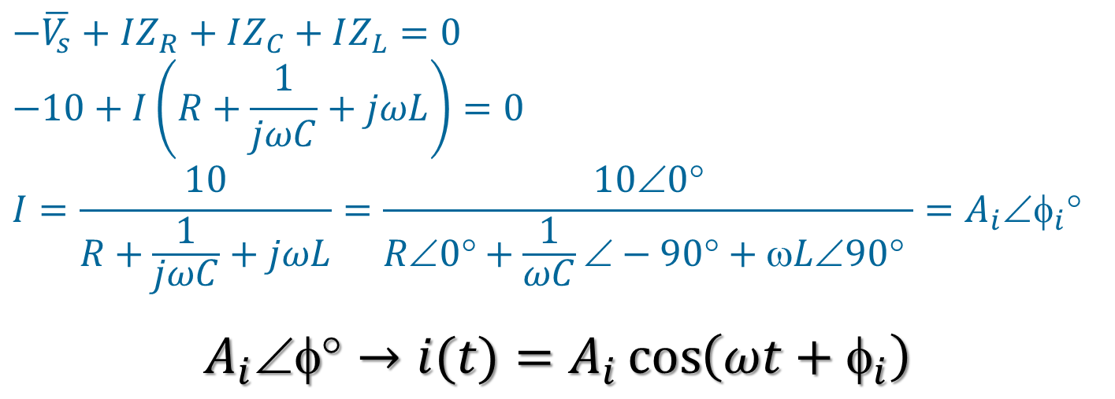

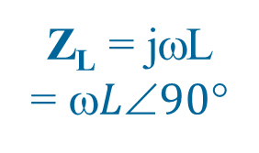
9.1 Motivation
How does one analyse an AC circuit?
Method #2:
Frequency or Phasor domain
Z_{R} = R
= R ∠0°
Z_{C} = 1/jωC
= $\frac{1}{ωC}∠−90°$
I
KVL:
V_{s}
= 10∠0°
Z_{L} = jωL
= $L90$
$$−\overline{V_{s}}+\overline{V_{R}}+\overline{V_{C}}+\overline{V_{L}}=0$$
$$−\overline{V_{s}}+IZ_{R}+IZ_{C}+IZ_{L}=0$$
$$−10+I\left(R+\frac{1}{jωC}+jωL\right)=0$$
$$I=\frac{10}{R+\frac{1}{jωC}+jωL}=\frac{100}{R0+\frac{1}{ωC}−90+ωL90 }=A_{i}φ_{i}$$
$$A_{i}∠φ°→i(t)=A_{i}\cos\left(ωt+φ_{i}\right)$$

Slide 6
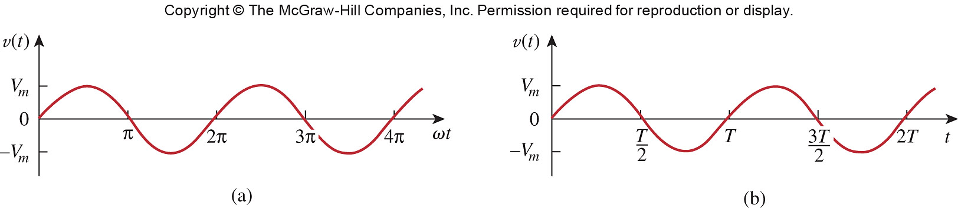

9.2 Sinusoids
A sinusoid is a signal that has the form of the sine or cosine function.
A general expression for the sinusoid:
where
V_{m} = the amplitude of the sinusoid
ω = the angular frequency in radians/s
t = time in seconds
ωt =argument of the sinusoid in radians
φ = the phase in radians or degrees
$$v\left(t\right)=V_{m}\sin\left(ωt+φ\right)$$
/ω
/ω
/ω
/ω

Slide 7
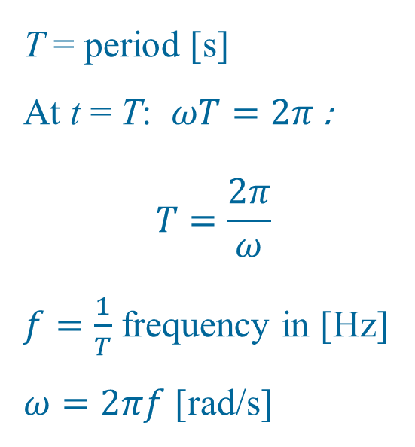
9.2 Sinusoids
V vs Time (not ωt)
T = period [s]
At t = T: $ωT=2π$:
$$T=\frac{2π}{ω}$$
$f=\frac{1}{T}$ frequency in [Hz]
$ω=2πf$ [rad/s]

Slide 8
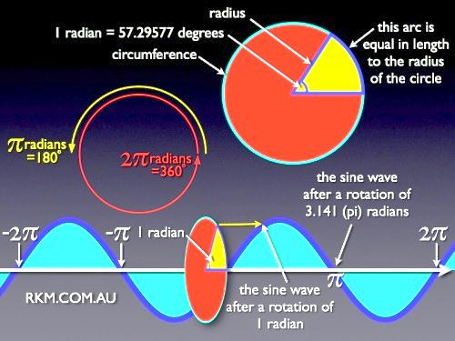
9.2 Sinusoids
Radians vs Degrees
http://www.rkm.com.au/ANIMATIONS/animation-sine-wave.html

Slide 9
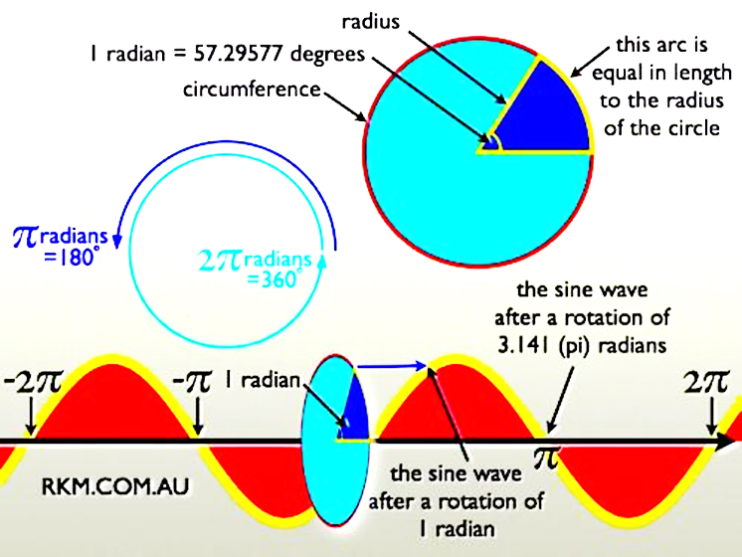
9.2 Sinusoids
Radians vs Degrees
http://www.rkm.com.au/ANIMATIONS/animation-sine-wave.html

Slide 10
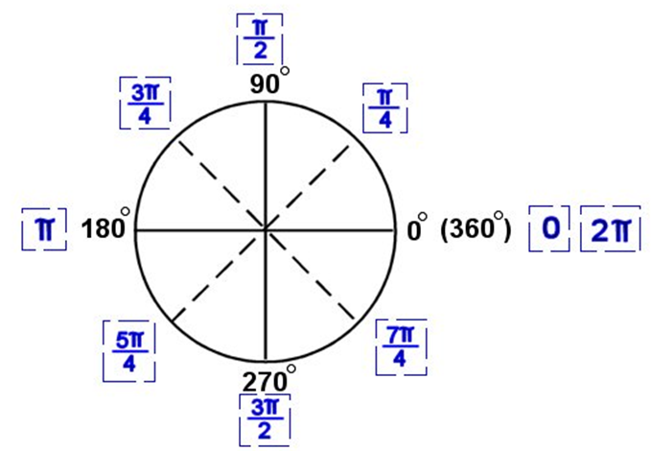
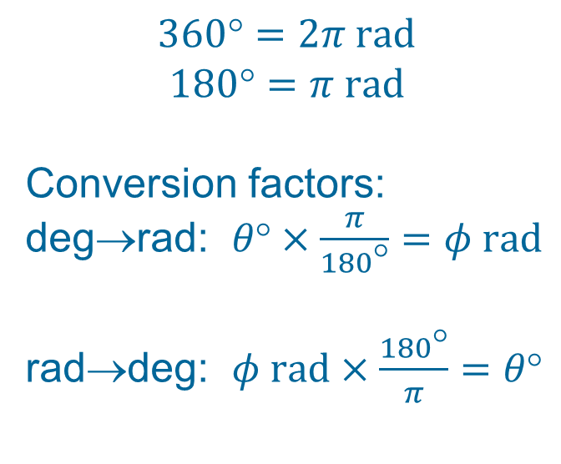
9.2 Sinusoids
Radians ↔ Degrees
$$360=2π rad$$
$$180=π rad$$
Conversion factors:
deg→rad: $θ°×\frac{π}{180°}=φ rad$
rad→deg: $φ rad×\frac{180°}{π}=θ°$

Slide 11
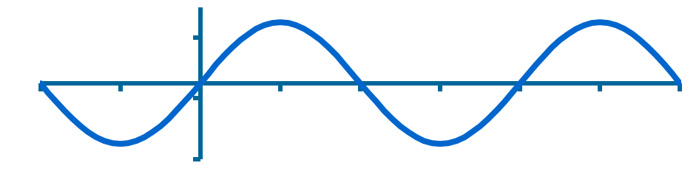
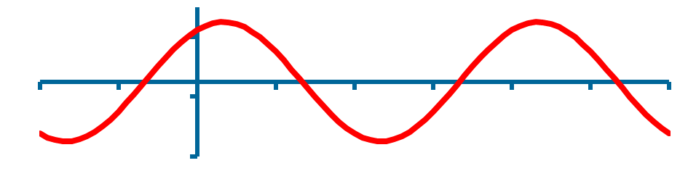
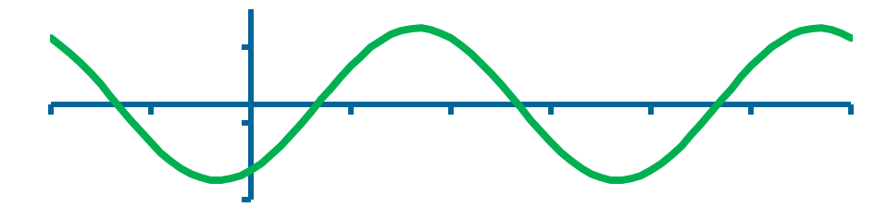
9.2 Sinusoids
Phase Angle φ [rad or °]
v(t) = V_{m}sin(ωt+φ)
φ = 0
ωt
v(t) = 0 if ωt+φ = 0
But φ = 0∴ ωt = 0
∴ v(t) = 0 when t = 0
φ
π
180°
2π
360°
v(t) = 0 if ωt+φ = 0
∴ ωt = –φ
But φ > 0 ∴ ωt = negative
∴ v(t) = 0 when t < 0
0-x moves φ° to left
φ > 0
ωt
φ
π
2π
φ < 0
v(t) = 0 if ωt+φ = 0
∴ ωt = –φ
But φ < 0 ∴ ωt = positive
∴ v(t) = 0 when t > 0
0-x moves φ° to right
φ
ωt
π
2π

Slide 12
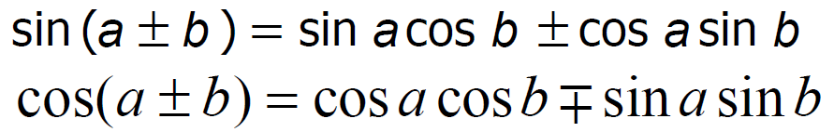
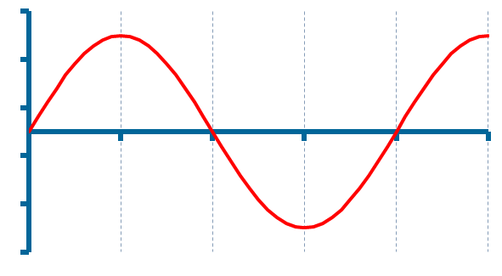
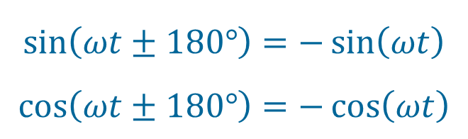
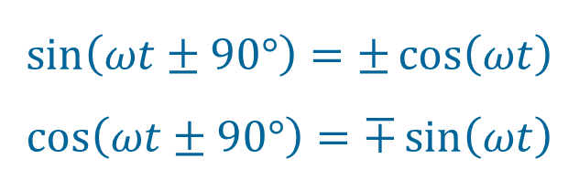
9.2 Sinusoids
Trigonometric identities: Special Cases
b = π
$$\sin\left(ωt±180°\right)=−\sin\left(ωt\right)$$
$$\cos\left(ωt±180°\right)=−\cos\left(ωt\right)$$
sin(ωt)
= cos(ωt –90°)
ωt
π/2
π
2π
b = π/2
$$\sin\left(ωt±90°\right)=±\cos\left(ωt\right)$$
$$\cos\left(ωt±90°\right)=∓\sin\left(ωt\right)$$
cos(ωt)
= sin (ωt+90°)
ωt
π/2
π
2π

Slide 13
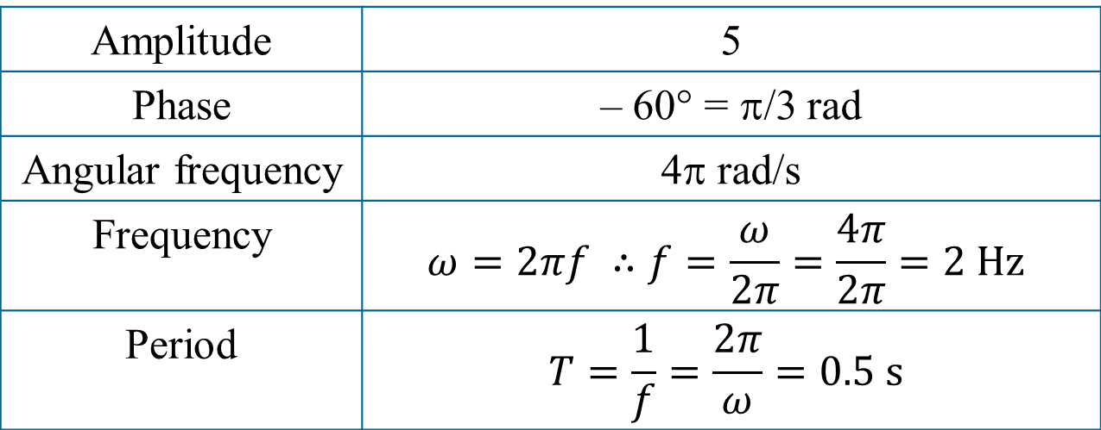
PP 9.1 For f(t) = 5 sin (4πt – 60°) , determine:
Amplitude; Phase; Angular frequency, Period and Frequency.
Amplitude | 5
Phase | – 60° = π/3 rad
Angular frequency | 4π rad/s
Frequency | $$ω=2πf ∴f=\frac{ω}{2π}=\frac{4π}{2π}=2 Hz$$
Period | $$T=\frac{1}{f}=\frac{2π}{ω}=0.5 s$$

Slide 14
9.2 Sinusoids
Graphical approach: Example
-sin(ωt)
cos(ωt + 90°)
cos(ωt – 90° + 180°)
sin(ωt + 180°)
- sin(ωt)
: Counter Clockwise
= positive phase shift
cos(ωt – 270°)
cos(ωt – 90° – 180°)
sin(ωt – 180°)
: Clockwise
= negative phase shift
- sin(ωt)
270°
-cos(ωt)
cos(ωt)
30°
cos(ωt – 30°)
cos(ωt – 90° + 60°)
sin(ωt)
sin(ωt + 60°)

Slide 15
9.2 Sinusoids
Graphical approach: Which one leads?
Always look at angle < 180°)
Remember: = positive
Vectors rotate counter clockwise,
So ask yourself: “Which one passes 0° first?”
(Both vectors must start in bottom two quadrants!)
i₁
0°
i₁ leads i₂
i₂
i₂
i₁
i₂
0°
0°
i₂ leads i₁
i₂ leads i₁
i₁

Slide 16
PP 9.2 Determine the phase angle between i₁ = -4sin(377t + 25°) and
i₂ = 5 cos(377t – 40°).
i₁
-sinωt
Analytical:
-4sin(377t)
= 4sin(377t + 180°)
i₁ = -4sin(377t + 25°)
= 4sin(377t + 25° – 180°)
= 4sin(377t – 155°)
= 4sin(377t + 90° – 245°)
= 4cos(377t – 245°)
= 4cos(377t + 115°) (–245+360=115 < 180°)
25°
Δφ = 25° + 90° + 40 °
= 155°
cosωt
40°
Hence:
Δφ = φ₁ – φ₂
= 115° – (-40 °)
= 155°
(Always give angle < 180°)
i₁ leads i₂ by 155° !!!
i₂
4sin(377t)
sinωt

Slide 17
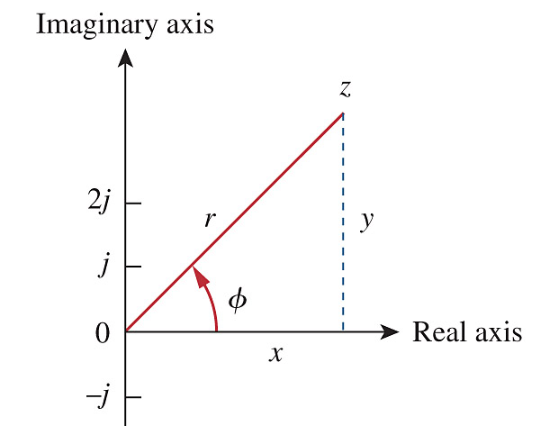
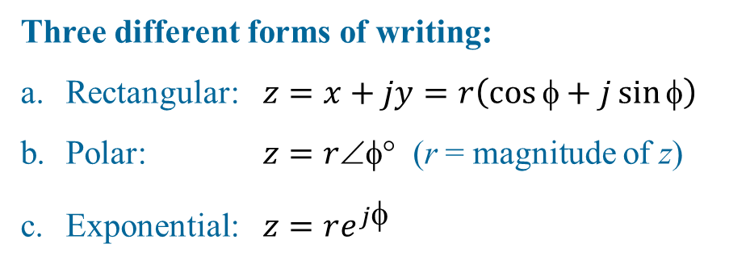
Ch. 9 L#2 9.3 Phasors
A phasor is a complex number that represents the amplitude and phase of a sinusoid (COSINE).
Complex Numbers:
z = x + j y
Complex Number Real part Imaginary part
Three different forms of writing:
Rectangular: $z=x+jy=r\left(\cos{φ}+j\sin{φ}\right)$
Polar: $z=r$ (r = magnitude of z)
Exponential: $z=re^{j}$
where

Slide 18
9.3 Phasors On the complex plane
Im
z = x + jy
= rcosφ + j rsinφ
= r(cosφ + j sinφ)
= re ^{jφ}
= r∠φ°
z = 3 + j2
r
y = r sin(φ)
φ
Re
x =r cos(φ)
Euler’s identity: e ^{±jφ} = cosφ ± jsinφ
A complex number consists out of:
A Real part (x) and Imaginary part (y):
z = x + jy
OR
A Magnitude (r) and a phase (φ):
z = r∠φ° = re ^{jφ}

Slide 19
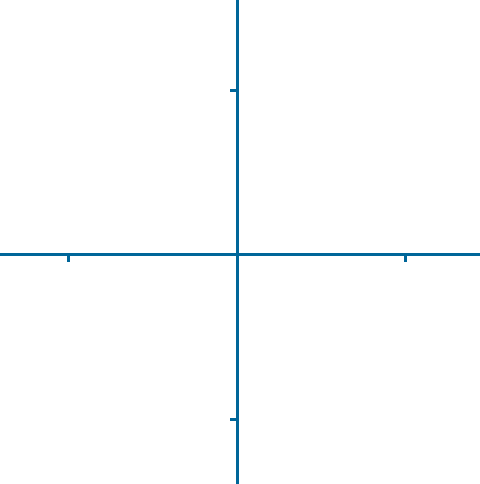
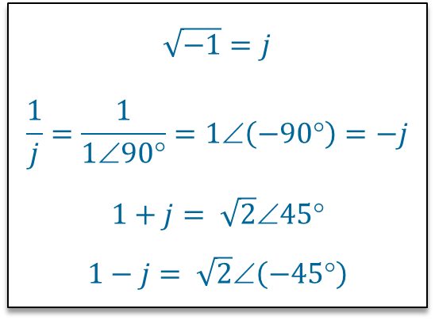
9.3 Phasors On the complex plane
Imaginary axis
j = 1∠90°
Real axis
-1
= 1∠180°
1
= 1∠0°
$$\sqrt{−1}=j$$
$$\frac{1}{j}=\frac{1}{1∠90°}=1∠\left(−90°\right)=−j$$
$$1+j= \sqrt{2}∠45°$$
$$1−j= \sqrt{2}∠\left(−45°\right)$$
-j = 1∠-90°

Slide 20
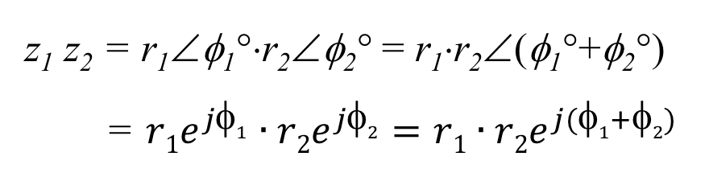
9.3 Phasors Arithmetic (1)
Assume: z = x + jy = r∠φ°
z₁ = x₁ + jy₁ = r₁∠φ₁°
z₂ = x₂ + jy₂ = r₂∠φ₂°
Addition (+): MUST WORK IN RECTANGULAR FORMAT
z₁ + z₂ = x₁ + jy₁ + x₂ + jy₂
= (x₁ + x₂) + j(y₁ + y₂)
Subtraction (–): MUST WORK IN RECTANGULAR FORMAT
z₁ – z₂ = (x₁ – x₂) + j(y₁ – y₂)
Multiplication (×): WORK IN POLAR FORMAT
z₁ z₂ = r₁∠φ₁°⋅r₂∠φ₂° = r₁⋅r₂∠(φ₁°+φ₂°)
= $r1e^{j1}∙r2e^{j2}=r1∙r2e^{j(1+2)}$

Slide 21
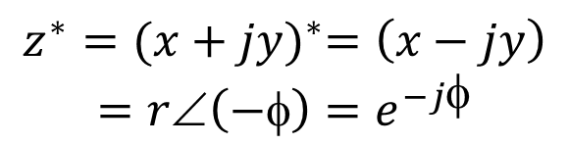

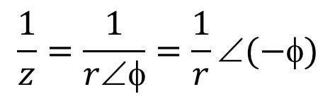
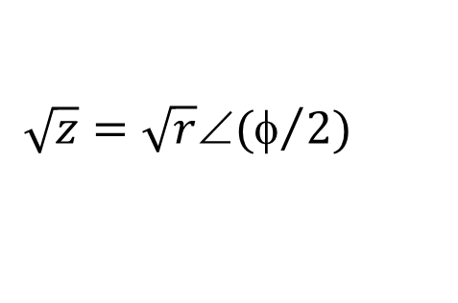
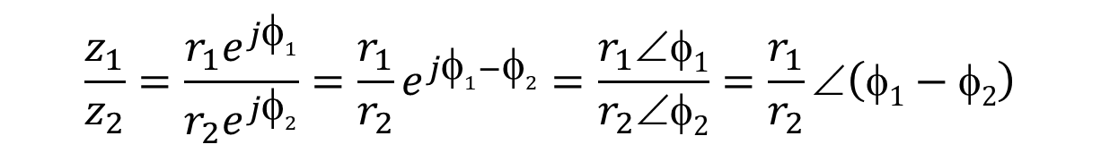
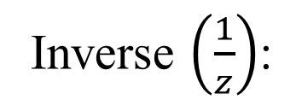
9.3 Phasors Arithmetic (2)
Division(÷): WORK IN POLAR FORMAT
$$\frac{z_{1}}{z_{2}}=\frac{r_{1}e^{j1}}{r_{2}e^{j2}}=\frac{r_{1}}{r_{2}}e^{j1−2}=\frac{r_{1}∠1}{r_{2}∠2}=\frac{r_{1}}{r_{2}}∠\left(1−2\right)$$
Root ():
$$\sqrt{z}=\sqrt{r}∠(φ/2)$$
Inverse $\left(\frac{1}{z}\right)$:
$$\frac{1}{z}=\frac{1}{r∠φ}=\frac{1}{r}∠(−φ)$$
Conjugate z*:
$$z^{∗}={(x+jy)}^{∗}=\left(x−jy\right)$$
$$=r∠\left(−φ\right)=e^{−jφ}$$

Slide 22
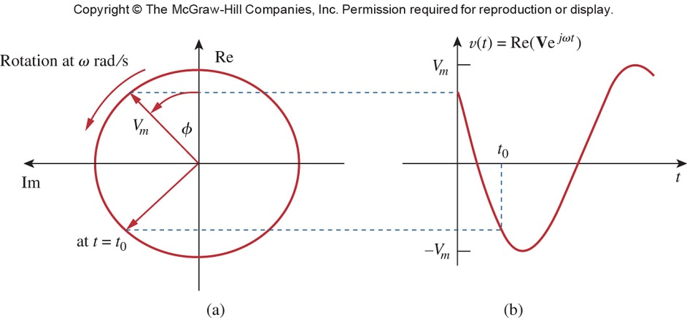


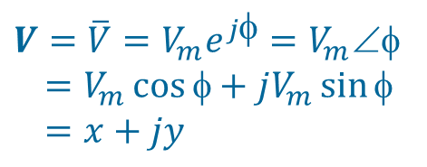
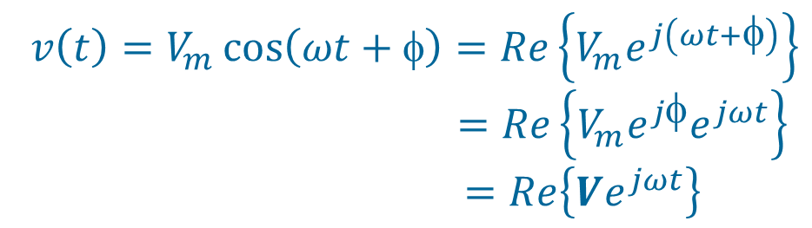
9.3 Phasors AC signal as a Phasor
Euler’s identity: e ^{±jφ} = cosφ ± j sinφ
$$Re\left\{e^{jφ}\right\}=\cos{φ}$$
$$Im\left\{e^{jφ}\right\}=\sin{φ}$$
$$v\left(t\right)=V_{m}\cos\left(ωt+φ\right)=Re\left\{V_{m}e^{j\left(ωt+φ\right)}\right\}$$
$=Re\left\{V_{m}e^{jφ}e^{jωt}\right\}$
$=Re\left\{Ve^{jωt}\right\}$
$$e^{jωt}=\cos{ωt}+j\sin{ωt}$$
$$V=\overline{V}=V_{m}e^{jφ}=V_{m}∠φ$$
$=V_{m}\cos{φ}+jV_{m}\sin{φ}$
$=x+jy$

Slide 23
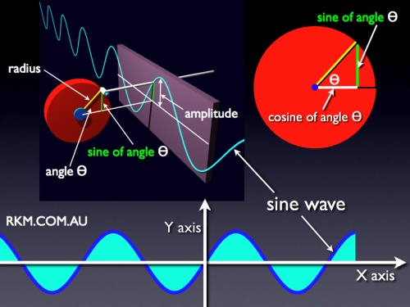
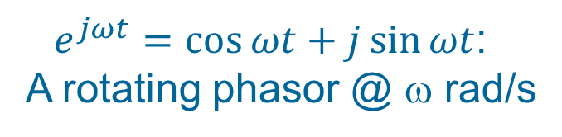

9.3 Phasors AC signal as a Phasor
$Re\left\{Ve^{jωt}\right\}$
$e^{jωt}=\cos{ωt}+j\sin{ωt}$:
A rotating phasor @ ω rad/s
http://www.rkm.com.au/ANIMATIONS/animation-sine-wave.html

Slide 24
9.3 Phasors Transformations
Transform a sinusoid to and from the time domain to the phasor domain:
(time domain) (phasor domain)
Amplitude and phase difference are two principal concerns in the study of voltage and current sinusoids.
Phasor will be defined from the cosine function in all our proceeding study. If a voltage or current expression is in the form of a sine, it will be changed to a cosine by subtracting from the phase.

Slide 25
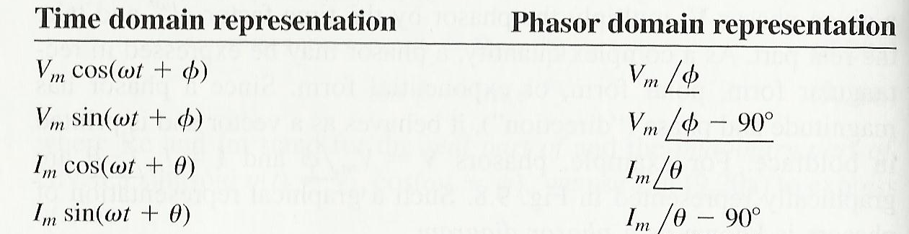

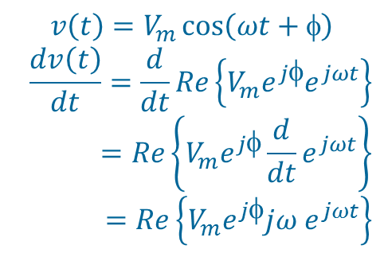
9.3 Phasors Sinusoid-phasor Transformation
$$v\left(t\right)=V_{m}\cos\left(ωt+φ\right)$$
$$\frac{dv\left(t\right)}{dt}=\frac{d}{dt}Re\left\{V_{m}e^{jφ}e^{jωt}\right\}$$
$$=Re\left\{V_{m}e^{jφ}{\frac{d}{dt}e}^{jωt}\right\}$$
$$=Re\left\{V_{m}e^{jφ}jω e^{jωt}\right\}$$
$$Vjω$$

Slide 26

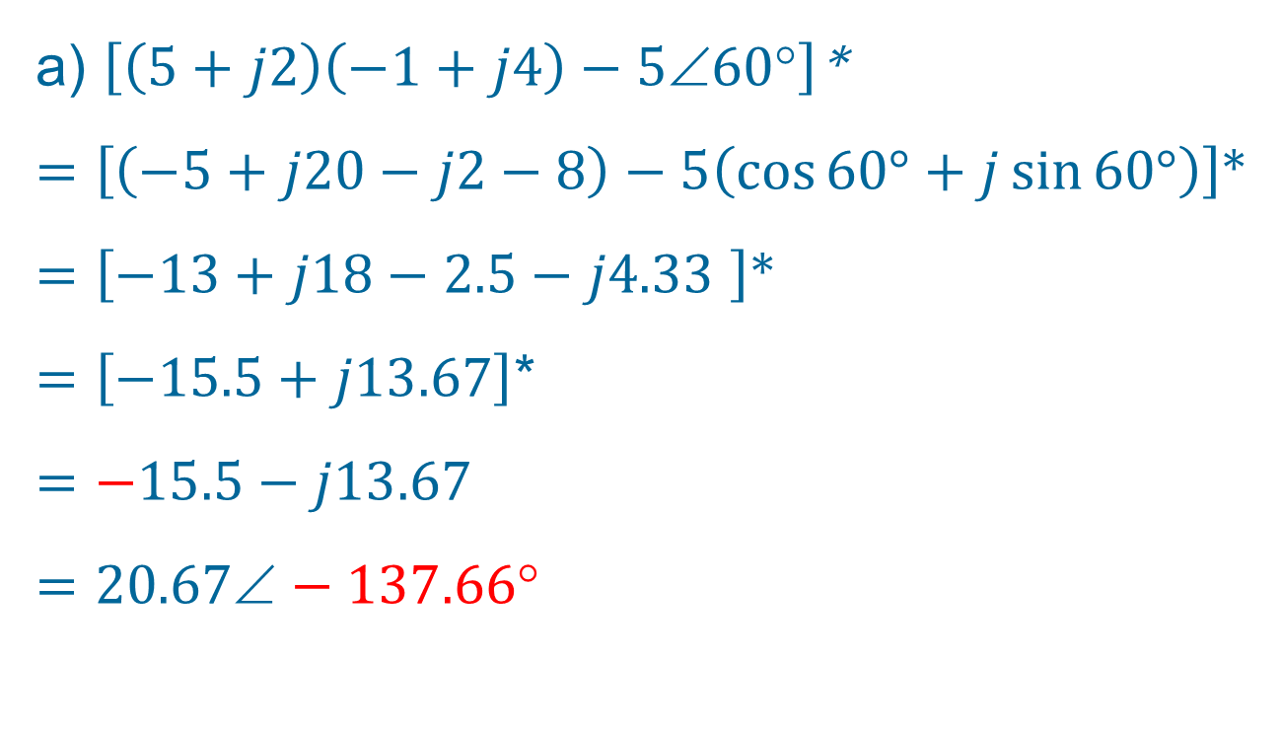
PP 9.3 Evaluate the following complex numbers:
a) $\left[\left(5+j2\right)\left(−1+j4\right)−5∠60°\right]$*
a) $\left[\left(5+j2\right)\left(−1+j4\right)−5∠60°\right]$*
$=\left[\left(−5+j20−j2−8\right)−5\left(\cos{60°}+j\sin{60°}\right)\right]$*
$=\left[−13+j18−2.5−j4.33 \right]$*
$=\left[−15.5+j13.67\right]$*
$$=−15.5−j13.67$$
$$=20.67−137.66$$

Slide 27
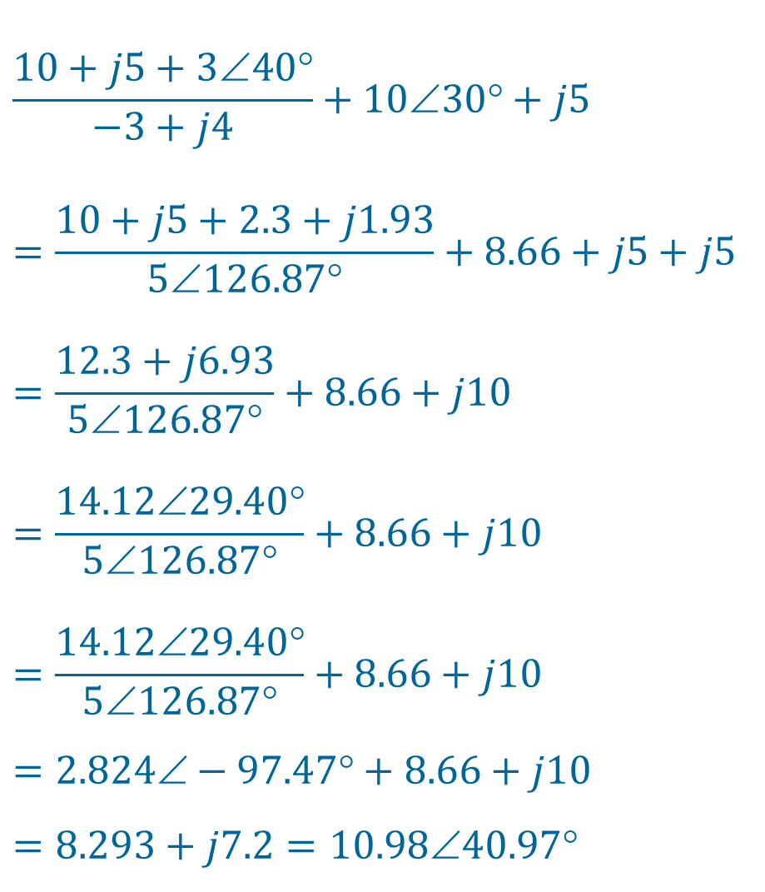
PP 9.3 Evaluate the following complex numbers:
b)
$$\frac{10+j5+3∠40°}{−3+j4}+10∠30°+j5$$
$$=\frac{10+j5+2.3+j1.93}{5∠126.87°}+8.66+j5+j5$$
$$=\frac{12.3+j6.93}{5∠126.87°}+8.66+j10$$
$$=\frac{14.12∠29.40°}{5∠126.87°}+8.66+j10$$
$$=\frac{14.12∠29.40°}{5∠126.87°}+8.66+j10$$
$$=2.824−97.47+8.66+j10$$
$$=8.293+j7.2=10.9840.97$$

Slide 28
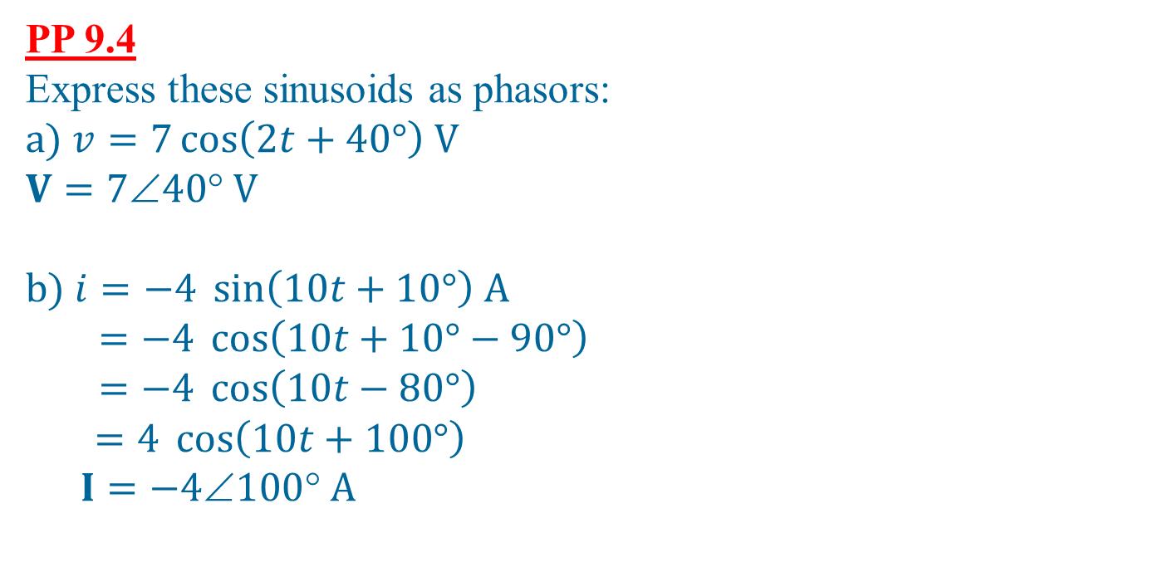
PP 9.4 Express these sinusoids as phasors:
$$a) v=7\cos\left(2t+40°\right) V$$
$$V=740 V$$
$$b) i=−4 \sin\left(10t+10°\right) A$$
$$=−4 \cos\left(10t+10°−90°\right)$$
$$=−4 \cos\left(10t−80°\right)$$
$=4 \cos\left(10t+100°\right)$
$$I=−4100 A$$

Slide 29
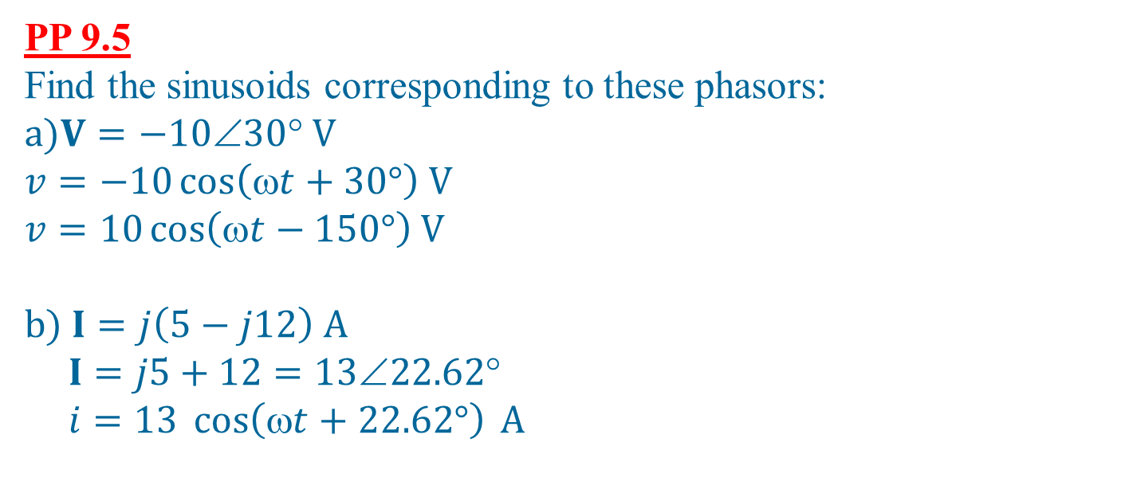
PP 9.5 Find the sinusoids corresponding to these phasors:
$$a)V=−1030 V$$
$$v=−10\cos\left(ωt+30°\right) V$$
$$v=10\cos\left(ωt−150°\right) V$$
$$b) I=j\left(5−j12\right) A$$
$$I=j5+12=1322.62$$
$$i=13 \cos\left(ωt+22.62°\right) A$$

Slide 30
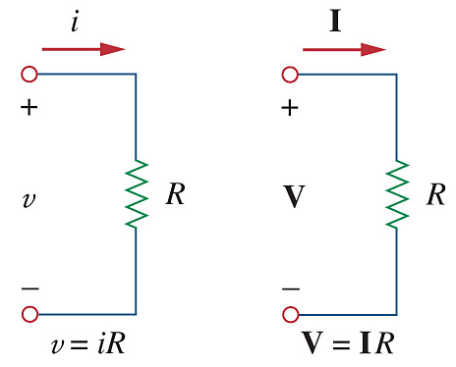
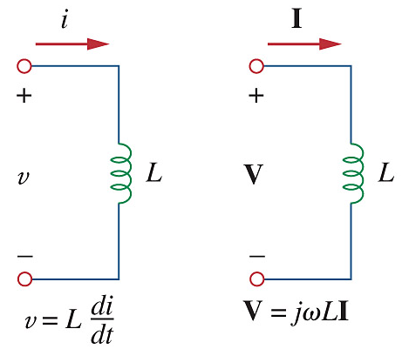
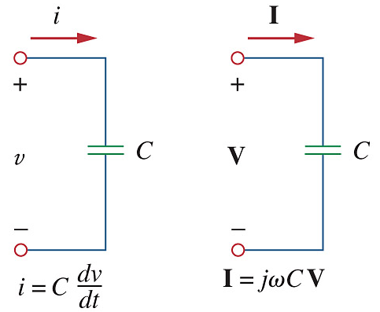
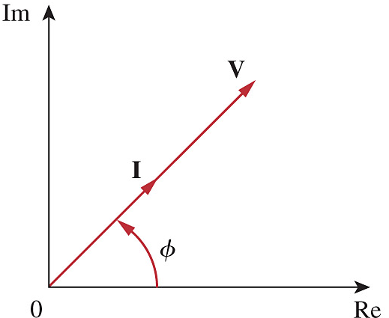
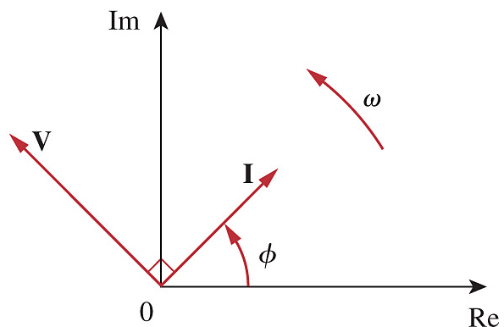

Ch. 9 L#3 9.4 Phasors and Circuit Elements
Resistor:
Inductor:
Capacitor:
V & I in phase
V leads I
I lags V
I leads V
V lags I
C I V I L

Slide 31
9.4 Phasors and Circuit Elements Voltage-Current Relationship
Summary of voltage-current relationship
Element | Time domain | Frequency domain
R
L
C

Slide 32
9.5 Impedance and Admittance
The impedance Z of a circuit is the ratio of the phasor voltage V to the phasor current I, measured in ohms Ω.
where R = Re of Z = the resistance and X = Im of Z = the reactance. Positive X is for L and negative X is for C.
The admittance Y is the reciprocal of impedance, measured in siemens (S).

Slide 33
9.5 Impedance and Admittance
Impedances and admittances of passive elements
Element | Impedance | Admittance
R
L
C

Slide 34
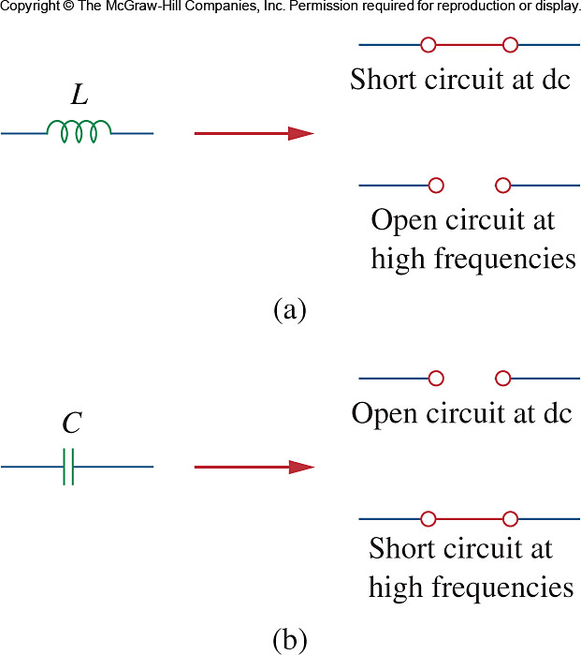
9.5 Impedance and Admittance
Remember: ω = 2πf
f = 0 ⇒ DC ⇒ Z_{L} = 0 ⇒ Short Circuit
f = ∞ ⇒ high AC ⇒ Z_{L} = ∞ ⇒ Open Circuit
f = 0 ⇒ DC ⇒ Z_{C} = ∞ ⇒ Open Circuit
f = ∞ ⇒ high AC ⇒ Z_{C} = 0 ⇒ Short Circuit

Slide 35





9.5 Impedance and Admittance
$$Z=R+jωL=R+jX_{L}$$
$$∴X_{L}=ωL$$
Impedance
Resistance
Reactance
$$Z=R+\frac{1}{jωC}=R−j\frac{1}{ωC}=R+jX_{C}$$
$$∴X_{C}=−\frac{1}{ωC}$$
$$Z=R+jX= \left|Z\right|∠θ$$
$$\left|Z\right|=\sqrt{R^{2}+X^{2}} θ=\tan^{−1}{\frac{X}{R}}$$
$$Y=\frac{1}{Z}=G+jB$$
Im
Z
X = Z sinθ
jX
Z
θ
R = Z cosθ
θ
Admittance
Conductance
Susceptance
R
Re

Slide 36
9.5 Impedance and Admittance
After we know how to convert RLC components from time to phasor domain, we can transform a time domain circuit into a phasor/frequency domain circuit.
Hence, we can apply the KCL laws and other theorems to directly set up phasor equations involving our target variable(s) for solving.

Slide 37
PP 9.8 If voltage v = 10 cos(100t + 30°) V is applied to a 50 μF capacitor, calculate the current through the capacitor.
Step 1: Convert from time to phasor domain
v = 10 cos(100t + 30°) ⇒ V = 10∠30° V
Z = jX_{C} = j(-1/ωC) = –j/(100 × 50×10⁻⁶)
= – j200 Ω
= 200 ∠–90° Ω
Step 2: Apply usual Laws and Theorems
I = V / Z = 10∠30° / 200 ∠–90°
= 50 ∠(30 – (–90))° mA
= 50 ∠120° mA
Step 3: Convert from phasor to time domain
i(t)= 50 cos(100t +120°) mA

Slide 38

PP 9.9 Determine v(t) and i(t).
Step 1: Convert from time to phasor domain
v_{s} = 20 sin(10t + 30°) = 20 cos(10t – 60°)
⇒ V_{s} = 20∠–60° V
Z = R + jX_{L} = R + jωL = 4 + j(10 × 0.2)
= 4 + j2 Ω
= 4.47 ∠26.57° Ω
Step 2: Apply usual Laws and Theorems
I = V / Z = 20∠–60° / 4.47∠26.57°
= 4.47 ∠–86.57 ° A
V_{L} = IZ_{L} = 4.47∠–86.57 ° × 2∠90°
= 8.944∠3.43° V
Step 3: Convert from phasor to time domain
i(t)= 4.47 cos(10t – 86.57 °) A
v_{L}(t)= 8.944 cos(10t + 3.43 °) V

Slide 39




AC Circuit analysis Laws and Theorems
KVL: –V + V₁ + V₂ = 0
V = IZ₁ + IZ₂
Z in series: Z_{T} = Z₁ + Z₂
Voltage division: $V_{1}=V\frac{Z_{1}}{Z_{1}+Z_{2}}$
KCL: I = I₁ + I₂
Z in //: Z// = $\frac{Z_{1}Z_{2}}{Z_{1}+Z_{2}}$
Current division: $I_{1}=I\frac{Z_{2}}{Z_{1}+Z_{2}}$

Slide 40

AC Circuit analysis
Δ - Y
For a BALANCED load:
Z_{Δ} = 3Z_{Y}

Slide 41


PP 9.10 Determine the input impedance of the circuit at ω = 10 rad/s
Z_{C1} = jX_{C1} = j(-1/ωC1)
= –j/(10 × 0.5×10⁻³)
= – j200 Ω
= 200 ∠–90° Ω
Z_{L} = jX_{L} jωL = j(10 × 8)
= j80 Ω
= 80∠90° Ω
– j200 Ω
200 ∠–90° Ω
j80 Ω
80∠90° Ω
Z_{C2} = jX_{C2} = j(-1/ωC2)
= –j/(10 × 1×10⁻³)
= – j100 Ω
= 100 ∠–90° Ω
– j100 Ω
100 ∠–90° Ω

Slide 42

PP 9.10 - continued Determine the input impedance
– j200 Ω
200 ∠–90° Ω
j80 Ω
80∠90° Ω
Z// = Z_{C2} // (Z_{L} + 200)
= 100 ∠–90° // ( 200 + j80)
$$=\frac{100∠−90°×215.41∠21.8°}{−j100+(200+j80)}$$
$$=\frac{21.54×{10}^{3}∠−68.2°}{201∠−5.71°}$$
= 107.17∠–62.49°
= 49.505 – j95.05 Ω
– j100 Ω
100 ∠–90° Ω
Z_{in} = Z// + Z_{C1} + 80
= 49.505 – j95.05 –j200 + 80
= 129.51 – j295.05
= 322.22∠–66.30° Ω

